Slide 1


Title
AgentDiag
Calibrated Probabilistic Root-Cause Attribution for Multi-Agent LLM
By
G Shiva (CH.SC.U4AIE24020)
Pabbathi Nikhil (CH.SC.U4AIE24049)
Sri Nivya Saladi (CH.SC.U4AIE24064)
E Nishnath (CH.SC.U4AIE24088)
Notes:
1

Slide 2
Introduction
Modern LLM systems increasingly use multiple specialized agents such as planners, retrievers, coders, and reviewers working together.
When the final pipeline fails, the observed error does not directly reveal which agent introduced the original failure.
An early mistake may propagate through later agents, while a later agent may fail to detect or correct an existing error.
This project frames multi-agent failure diagnosis as a probabilistic root-cause attribution problem rather than a single-label classification problem.
Key idea:
Instead of saying “Agent 2 is responsible,” AgentDiag estimates a probability distribution over possible root causes.
Notes:
1

Slide 3
Problem Statement
Multi-agent LLM pipelines contain dependent stages, making failures difficult to localize.
Existing LLM-based diagnosis approaches often produce a single root-cause prediction rather than calibrated probabilities.
A diagnosis can be correct while its confidence is misleading—for example, predicting 90% confidence but being correct only 60% of the time.
Agent logs or intermediate outputs may sometimes be missing or incomplete, making deterministic diagnosis unreliable.
Agent reliability can also change over time, causing degradation that may only become visible after the final failure.
Consequence:
A system needs to identify who most likely caused the failure, how uncertain that attribution is, and whether its confidence is trustworthy.
Notes:
1

Slide 4
Literature Review
Benchmark & SOTA (Conferences)
Who&When (ICML 2025): introduced the failure-attribution benchmark; original baseline achieved 53.5% agent-level / 14.2% step-level accuracy.
AgenTracer (ICLR 2026): current state of the art on Who&When — the accuracy bar AgentDiag needs to clear.
Methodology & Evaluation Base (Journals)
Ensemble BN (JMS, 2024): peer-reviewed foundation for Bayesian Network parameter learning and inference.
Graph-based Confidence Calibration (TMLR, 2025): peer-reviewed foundation for the ECE/Brier calibration techniques used in AgentDiag.
Notes:
1

Slide 5
Objectives & Proposed Solution
Model dependencies between agent failures using a Bayesian Network.
Compute root-cause probabilities using hand-implemented Variable Elimination.
Learn model parameters from real multi-agent execution data instead of manually assigning probabilities.
Handle missing observations/logs through probabilistic inference.
Produce a calibrated probability distribution over candidate root causes.
Track changing agent reliability across multiple turns using an HMM.
AgentDiag combines:
Bayesian Network → Variable Elimination → Parameter Learning → Calibration → HMM
Notes:
1

Slide 6
Methodology / Algorithms & Techniques
Bayesian Network:
Models dependencies among agent failures.
Variable Elimination: Computes P(Agenti failed∣Pipeline Failure) via a custom, hand-rolled implementation (no probabilistic graph libraries used).
Parameter Learning: CPT values are estimated from actual pipeline runs.
Calibration:
Checks predicted probabilities against actual frequencies using ECE, Brier Score, and reliability diagrams.
HMM:
Tracks hidden agent reliability states over multiple turns.
Notes:
1

Slide 7
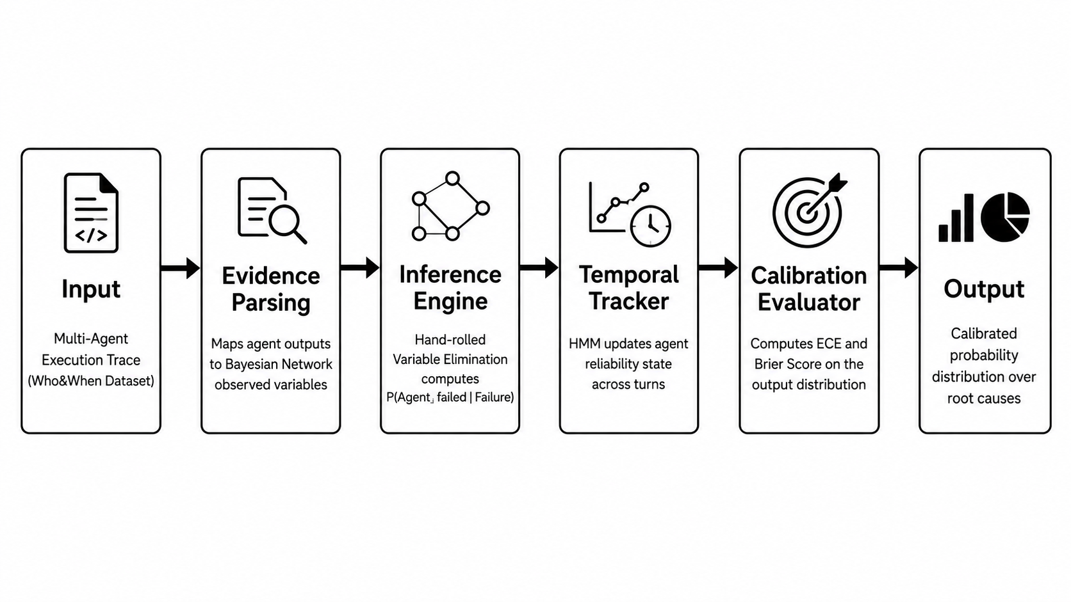

System Architecture
Notes:
Pipeline (accessible text description of the diagram): 1) Input: Multi-Agent Execution Trace (Who&When Dataset). 2) Evidence Parsing: map agent outputs to BN observed variables. 3) Inference Engine: hand-rolled Variable Elimination computes P(Agent_i failed | Failure). 4) Temporal Tracker: HMM updates agent state across turns. 5) Calibration Evaluator: computes ECE/Brier Score on the output distribution. 6) Output: calibrated probability distribution over root causes.

Slide 8
Expected Outcomes
Probability distribution over possible root-cause agents instead of a single guess.
Data-driven probabilistic model learned from actual executions.
Ability to reason with missing agent observations.
Quantitative calibration of diagnosis confidence.
Early identification of agent reliability degradation using HMM.
Evaluation against the Who&When benchmark, targeting competitive accuracy with current SOTA (AgenTracer) while providing superior calibration (ECE/Brier) and robust missing-evidence handling.
Future work: full implementation, quantitative evaluation and benchmark analysis.
Notes:
1

